Slide 1
Mazegame
Assignment2

Slide 2
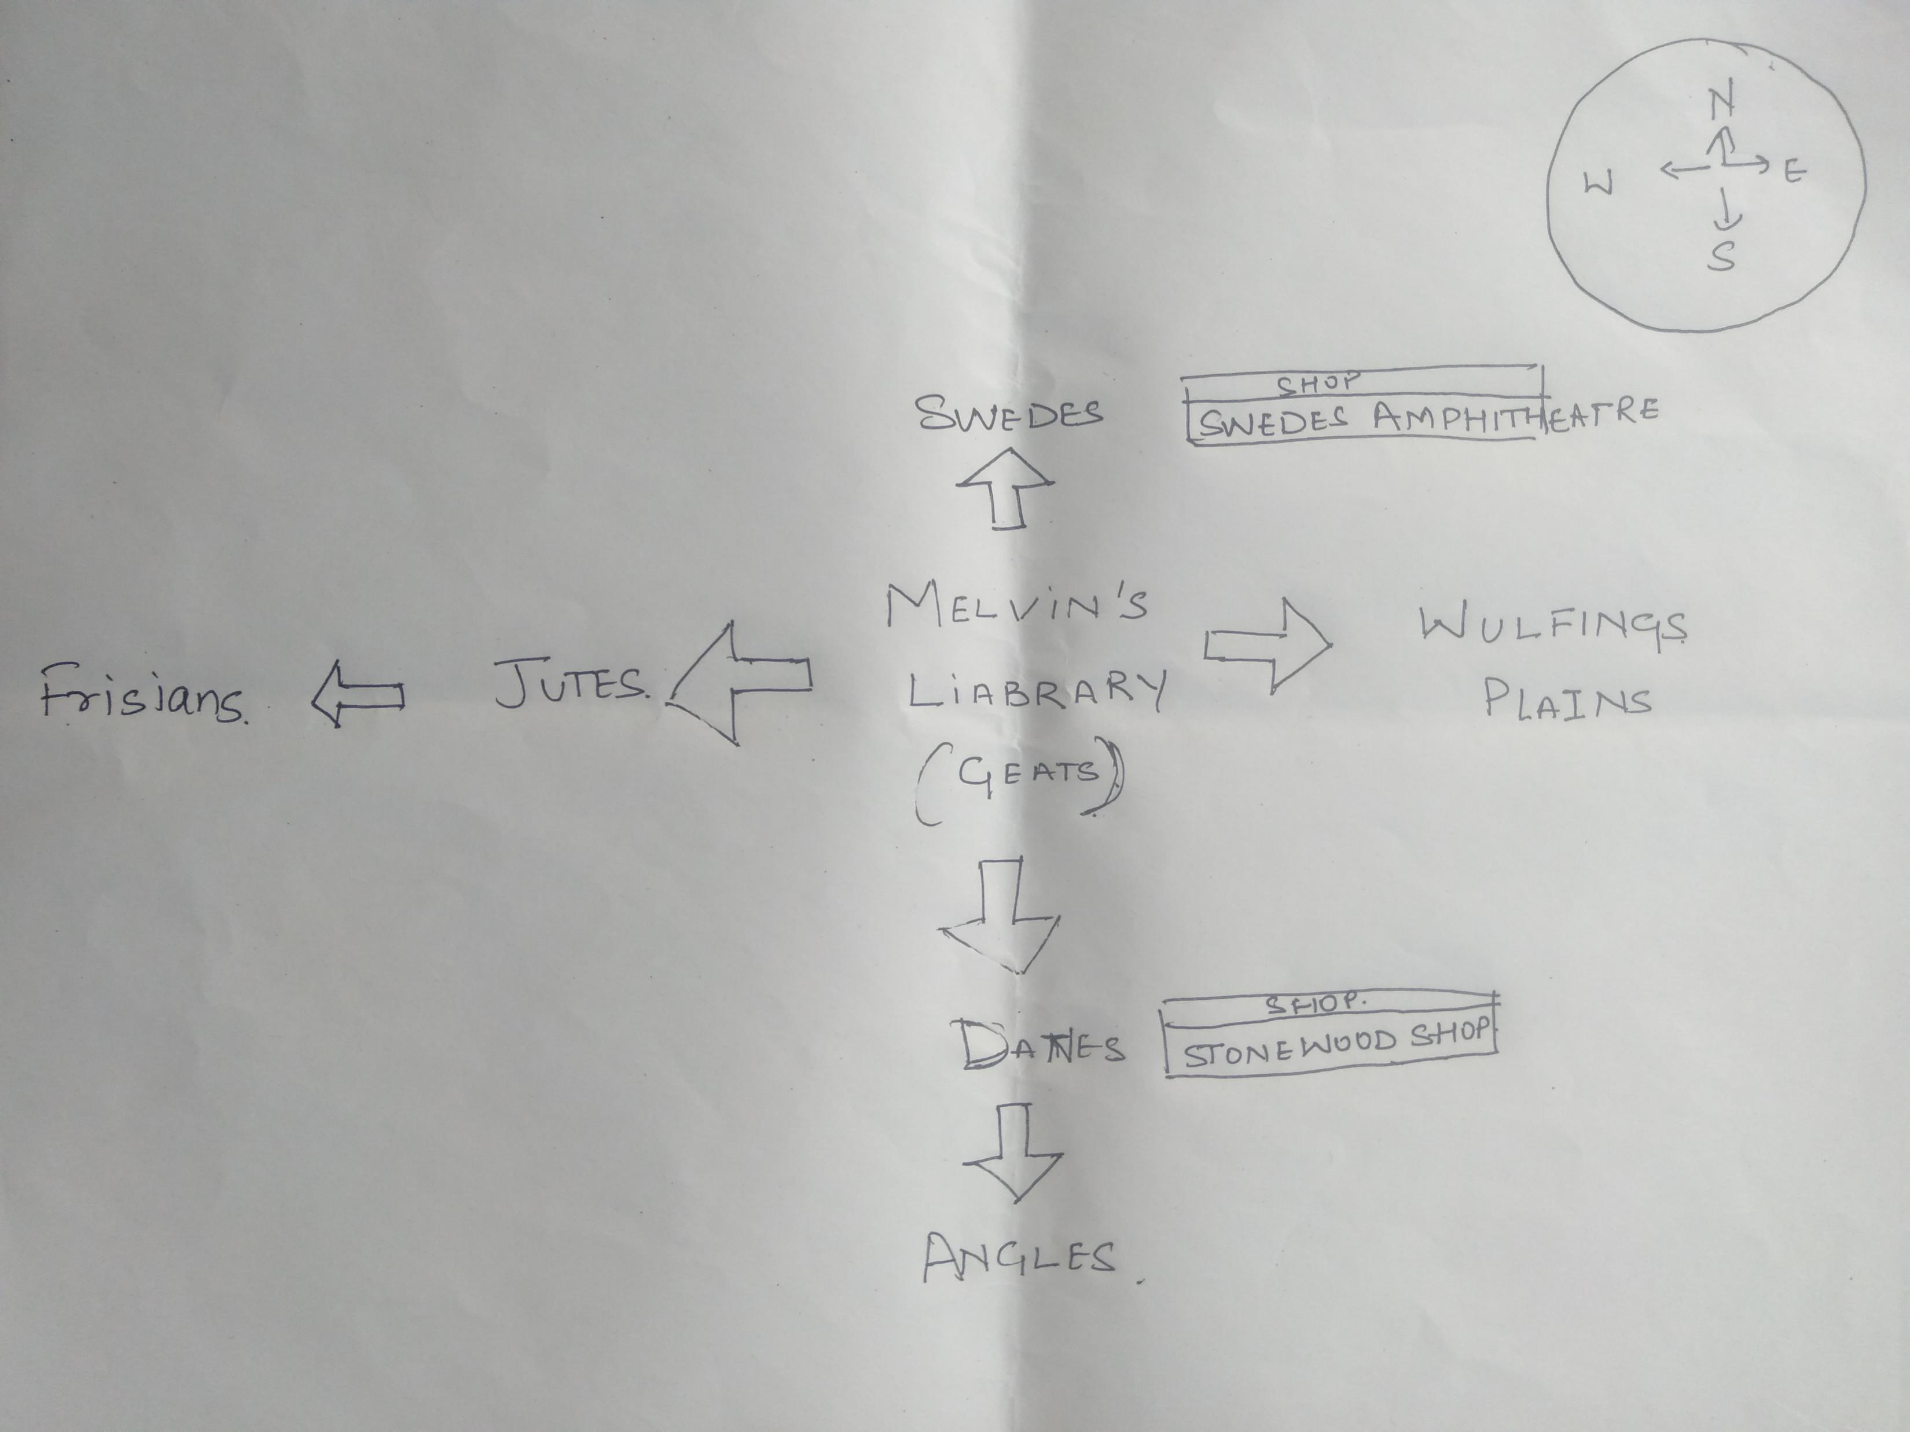
The hashmap with shops and locations

Slide 3
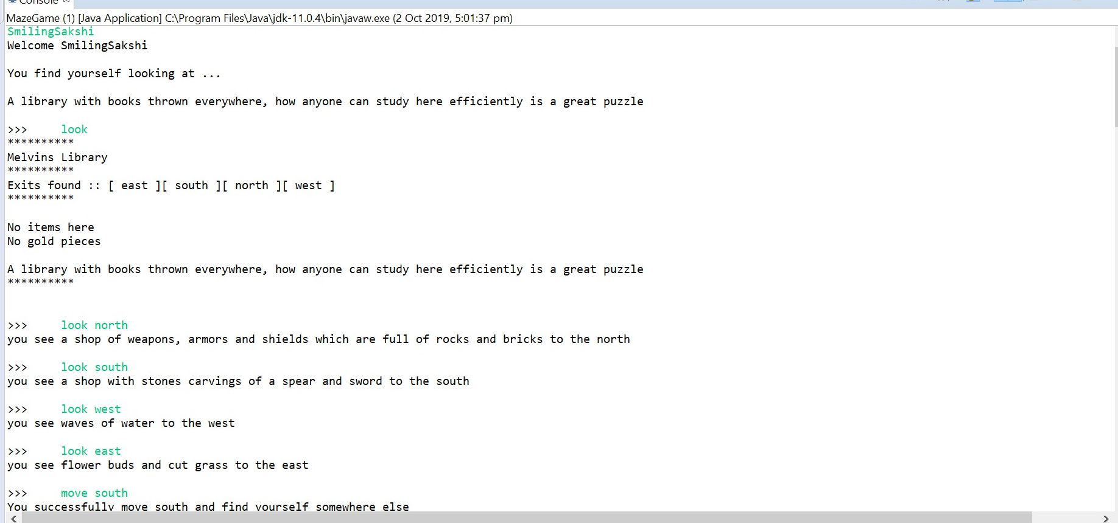
Locations and the shops

Slide 4
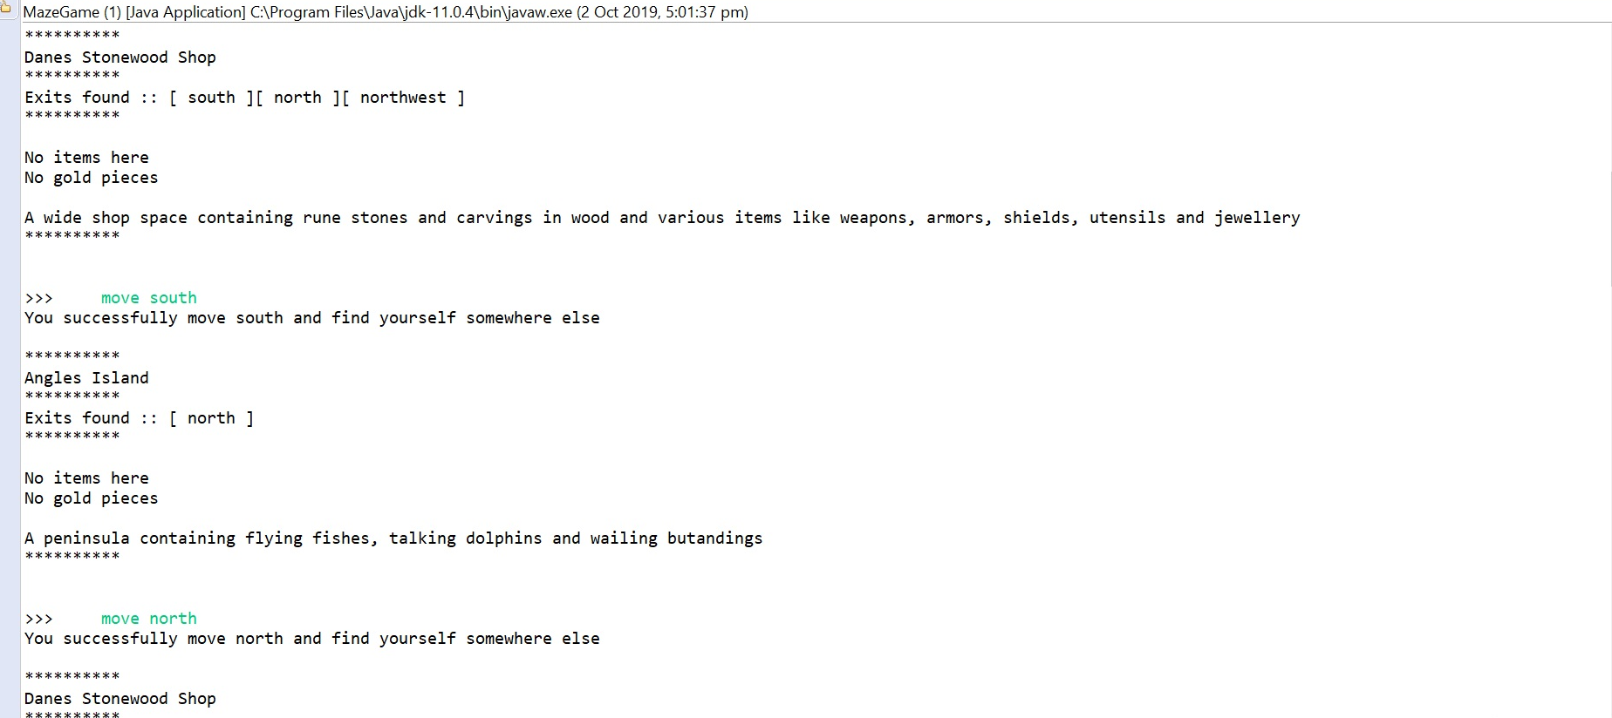
Locations and shops

Slide 5
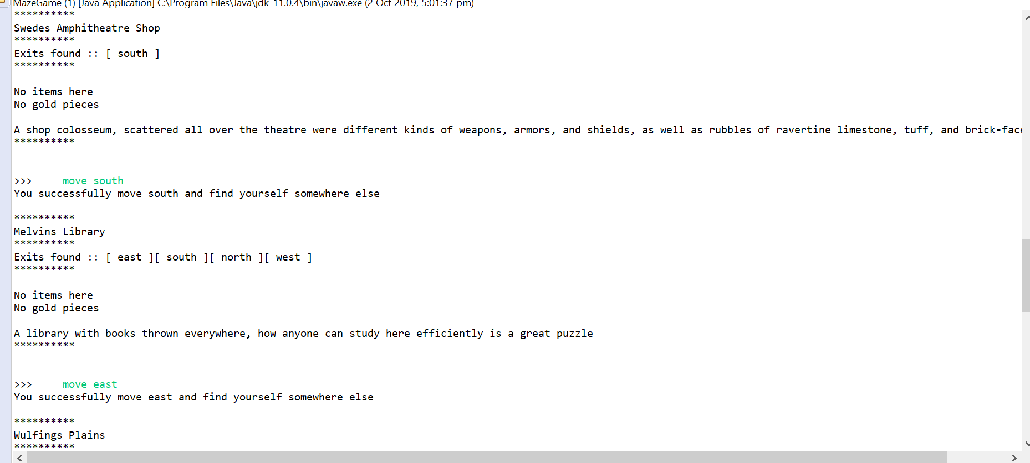
Locations and shops

Slide 6
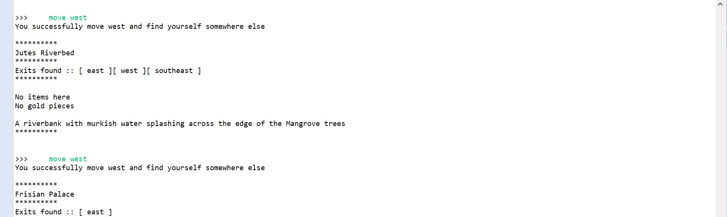
Locations and shop

Slide 7
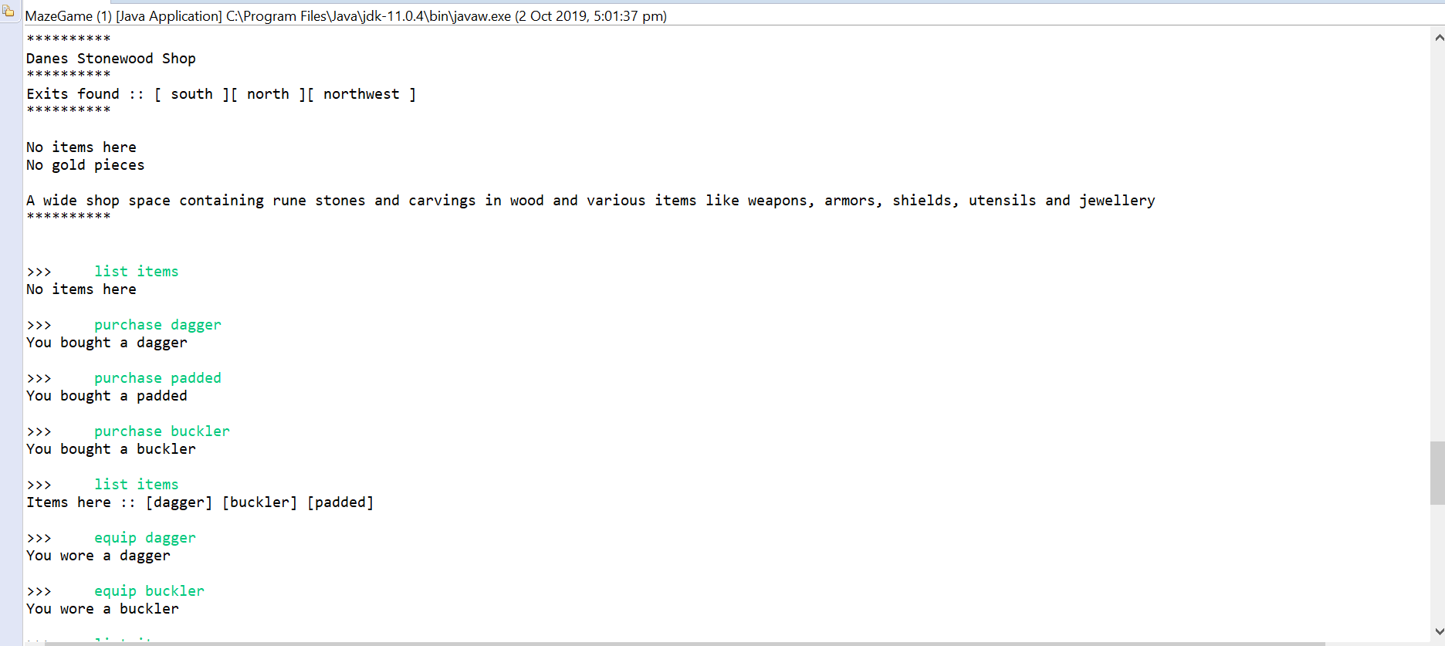
ListItems

Slide 8
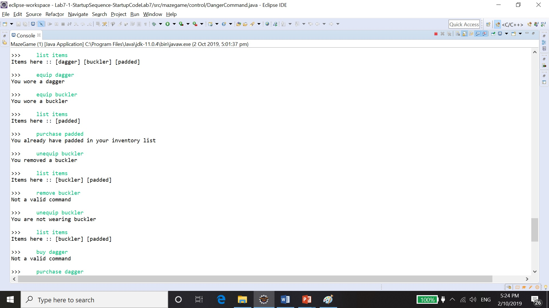
Equip Items

Slide 9
Unequip Items

Slide 10
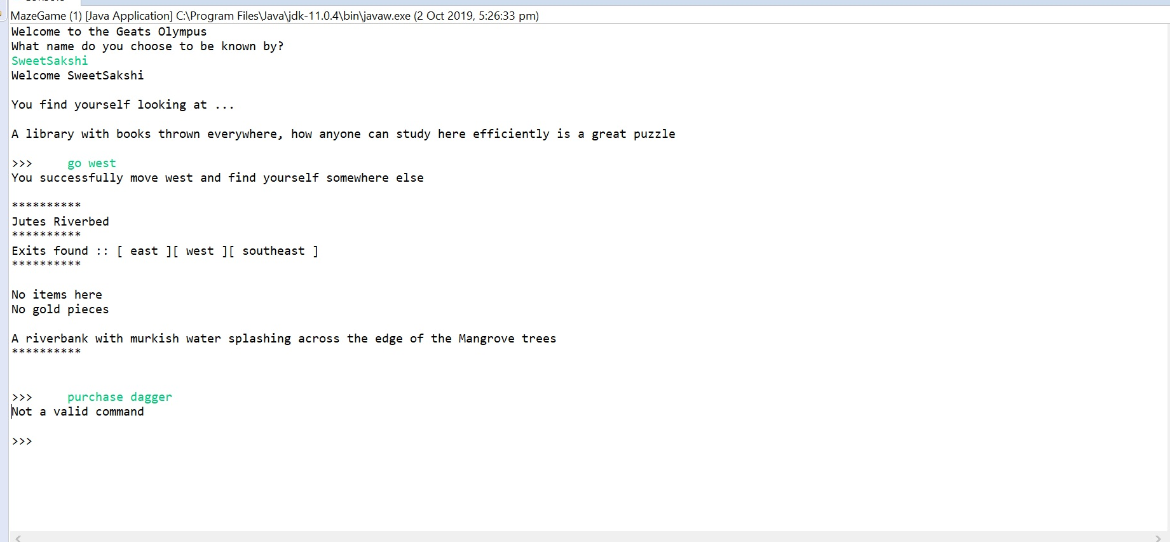
Purchase Items

Slide 11
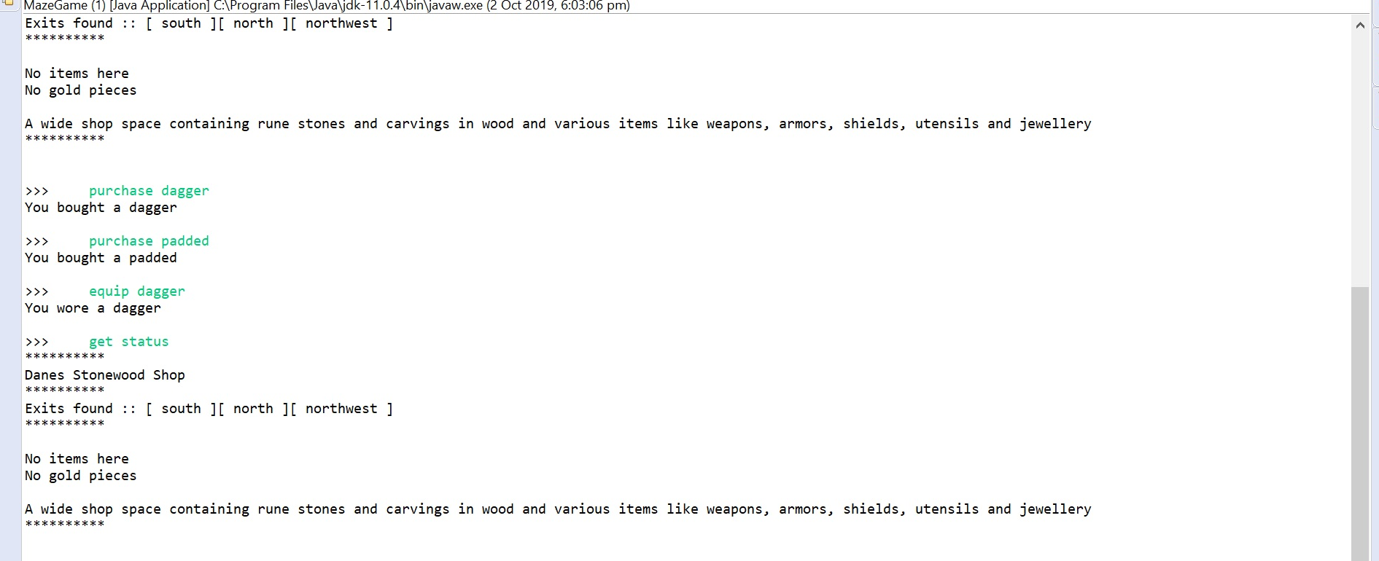
Get Maze Status

Slide 12
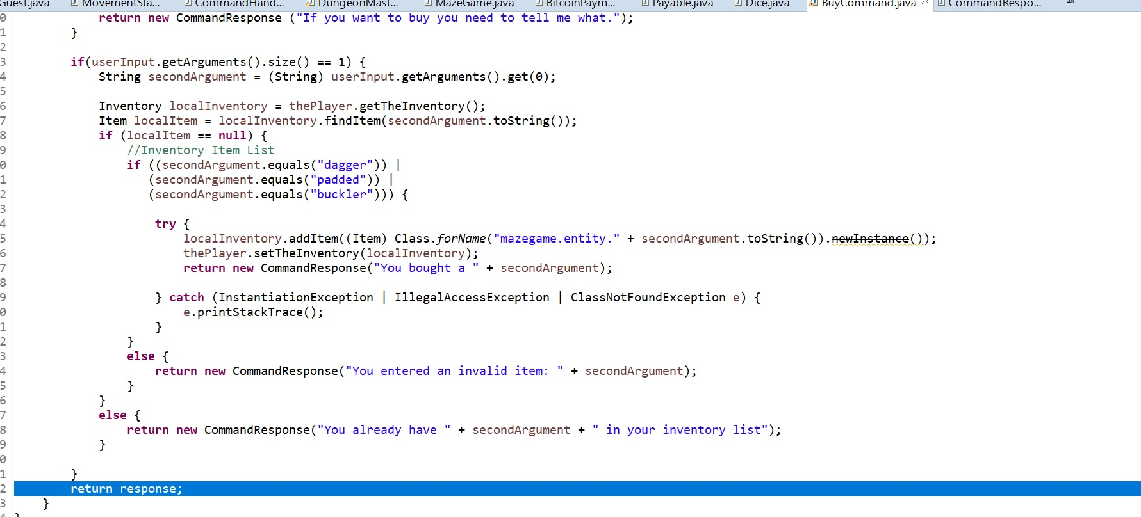
Buy Command

Slide 13
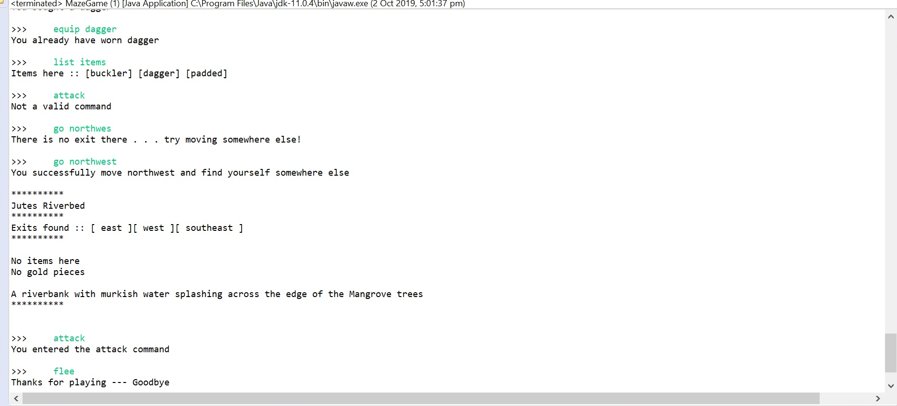
Attack

Slide 14
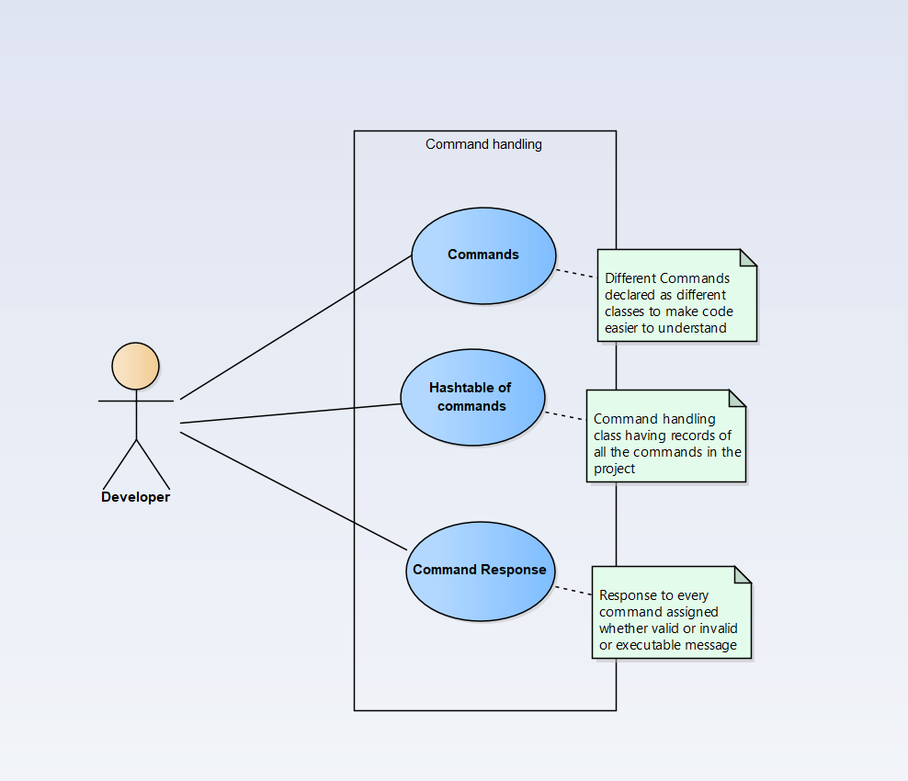
Command Handling
TO achieve abstraction and Encapsulation we made separate classes for each command and implemented a interface to achieve the encapsulation.

Slide 15
Methodology: Agile (Extreme Programming)Methodology
Less Documentation: We started without any use case diagrams , domain diagrams , class diagrams just started to code the pre handed code to achieve the functionality.
More coding: We tried to code little chunks to achieve one functionality at a time and then tested it just like agile model where small prototypes are ran.

Slide 16
Analysis
We were disappointed by the methodology as without the design of the project like the use case diagram, sequence diagram, domain diagram the working became quite complicated to carry on with. We were unable to make functionalities work with pre provided classes and classes.
On whole It was a good experience to make work with pre provided codes.

Slide 17


